Slide 1
Predicting PlanetTerp Professor Ratings
CMSC 320 – HW 4, Spring 2025
Boubacar Sall

Slide 2
Problem & Motivation
PlanetTerp: student-submitted ratings of UMD professors
▶️ Why predict ratings?
• Help students choose courses
• Potentially used to higher professors based on their qualities
▶️ Challenge: Cannot use existing average ratings directly

Slide 3
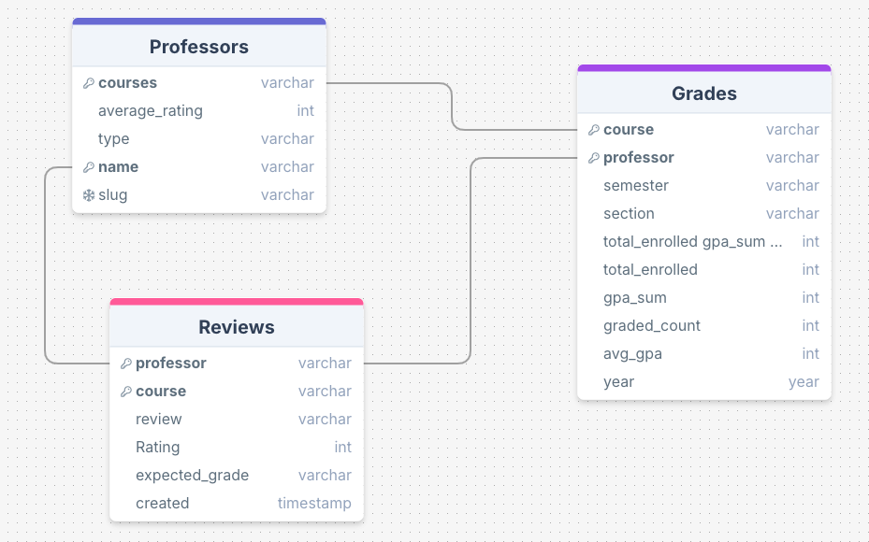
Data Sources & Table Creation
Extracted the data from the PlanetTerp website via API:
I split the data into 3 tables to
form a database schema structure

Slide 4
Data Cleaning
▶️ Reviews:
• 37,401 → 37,365 reviews (drop duplicates)
• Fill missing course names ("unknown")
• Add review_word_count
▶️ Grades:
• 71,543 rows
• Aggregate total_enrolled, graded_count, avg_gpa
▶️ Professors:
• 13,421 → 4,536 professors (with 1 review)
• Compute num_courses, semesters_taught
▶️ Final Table:
• 4,538 professors

Slide 5
Feature Engineering
🛠️ Feature Engineering:
• num_courses — number of distinct courses taught
• num_semesters_taught — semesters with recorded teaching
• review_count — number of student reviews
• avg_expected_grade — mapped to numeric scale
• avg_review_word_count — average review length
• total_enrolled_prof — total students enrolled across courses
• avg_gpa_prof — average GPA from grades table

Slide 6
Sentiment
🧠 Sentiment Analysis:
• Used VADER to score review text (–1 to +1)
• Aggregated average sentiment per professor

Slide 7
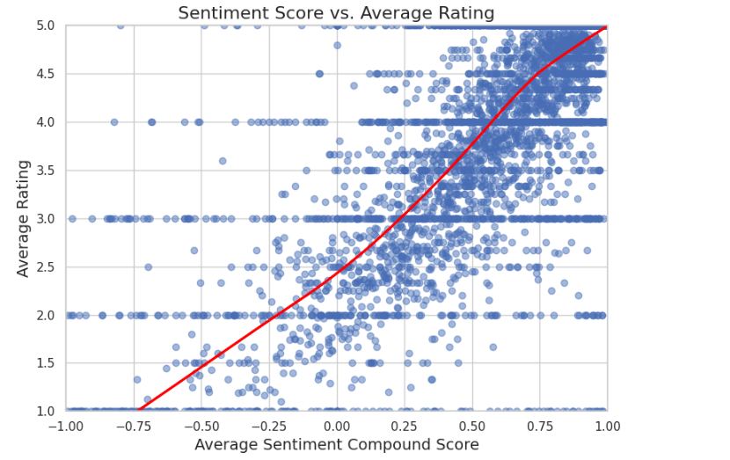
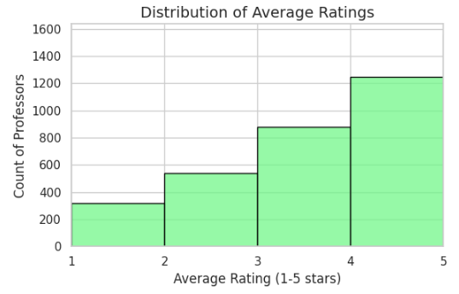
Exploratory Data Analysis

Slide 8
Modeling Approaches
🧩 Models Used:
• K-Nearest Neighbors (KNN)
• Random Forest
• XGBoost
🔎 Why These Models?
• Balance between simplicity, power, and speed

Slide 9
Model Evaluation Setup
🧪 Data Splitting:
• 70% Training Set
• 30% Test Set (held out for final evaluation)
🔄 Validation Strategy:
• 10-Fold Cross Validation
• Training set split into 10 folds
• Train on 9 folds, validate on 1 fold (repeated 10×)
• Used for hyperparameter tuning
🎯 Final Evaluation:
• After tuning, best model evaluated on full test set
• Metrics: RMSE (error), R² (variance explained)

Slide 10
Hyperparameter Tuning
⚙️ GridSearchCV Process:
• Defined a range of possible hyperparameters for each model
• Systematically tried all combinations across the grid
• Used 10-Fold Cross Validation to evaluate each combination
• Selected the hyperparameters that minimized RMSE on validation folds

Slide 11


Model Results
Most important Features
🎯 Best Model:
• XGBoost achieved the lowest RMSE and highest R²
Interpretation:
RMSE, meaning on average its predictions were off by about 0.65 stars on a 5-star rating scale.

Slide 12
Conclusions
• XGBoost achieved the best performance:
– Average prediction error of ~0.65 stars
– Explained 68% of variance in professor ratings (R² = 0.680)
• Key Features:
– avg_sentiment_compound was the most important predictor
– avg_expected_grade, avg_review_word_count, avg_gpa_prof also contributed
• Overall:
– Combining sentiment analysis with structured data successfully improved rating predictions

Slide 13
Next Steps
🚀 • Enhance Sentiment Analysis:
– Fine-tune using BERT models on review text for deeper language understanding
• Feature Engineering:
– Add course-level variables (e.g., difficulty ratings, course size)
• Deployment:
– Build a live API/dashboard to predict ratings for new professors

